Slide 1

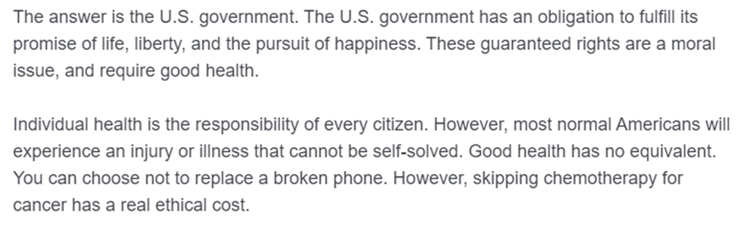
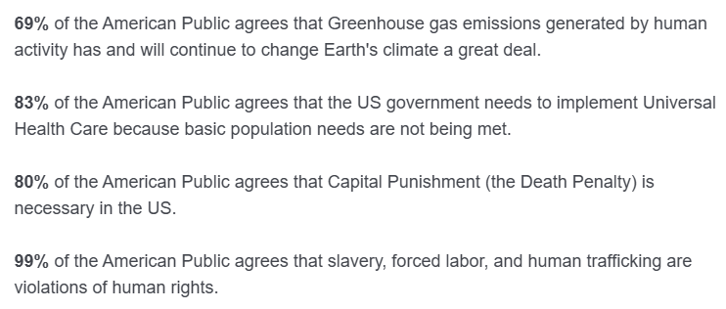
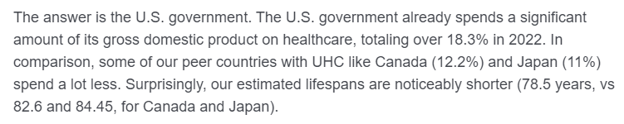
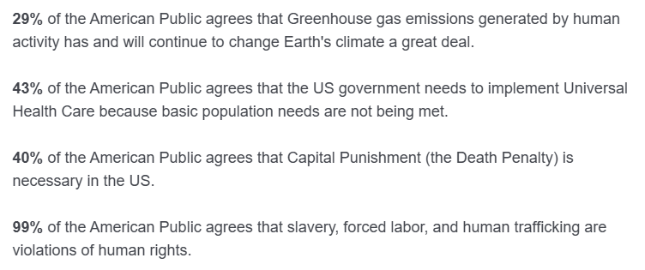
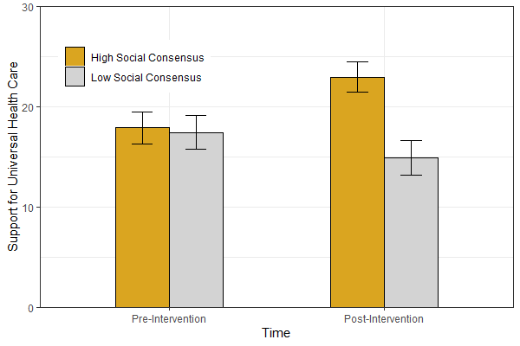
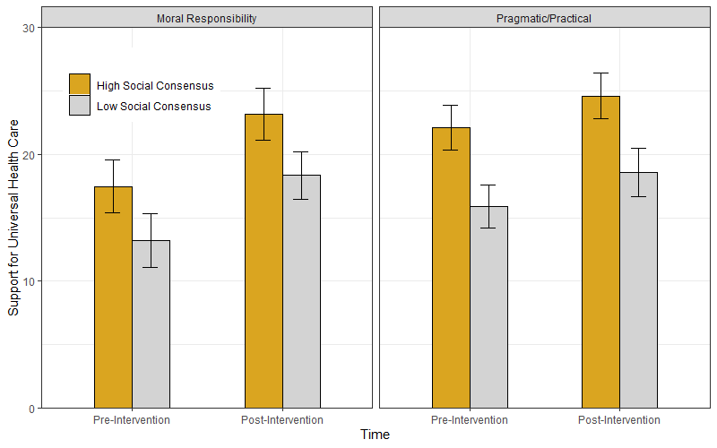

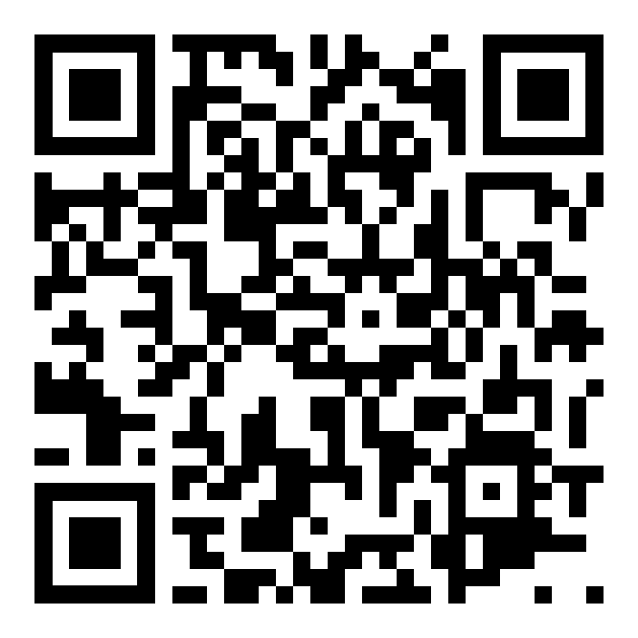




Perception of social consensus but not moral conviction affects support for universal health care
Sean X Duan, PhD. & Victoria A. Shaffer, PhD., University of Missouri – Columbia: Department of Psychological Sciences
seanxduan@gmail.com
Background and Objective
Method – Study 2
Discussion
Many healthcare beliefs (e.g., abortion access, vaccination) in the United States are becoming increasingly polarized.
We took advantage of this polarization to test two psychological theories on polarized belief change for US support of Universal Health Care (UHC)
Social Consensus: Conforming to popular perception can strongly influence support or opposition for a polarized topic.
Moral Conviction: The degree to which a belief is based on fundamental right and wrong (i.e., vegetarian for moral reasons vs. vegetarian for economic reasons) can likewise influence support or opposition for a polarized topic.
Study 2 was a replication and extension of Study 1
Participants (N=491; college students) were exposed to the same social consensus manipulations as in Study 1, and the outcome measure of support for UHC was the same.
For Study 2, participants were also provided one of two moral conviction manipulations:
Participants were given an essay centered on moral responsibility (increasing moral conviction)
Or an essay that centered on pragmatic/practical implementation (decreasing moral conviction)
The moral conviction essays were adapted from similar moral conviction manipulation work on other topics (GMO foods, surveillance technologies)
High social consensus condition increases support for UHC across Study 1 and Study 2; Figures 1 & 4
No significant main effect of moral conviction manipulation, or interaction with social consensus effect; Figure 3
Increasing or decreasing the saliency of the ‘moral’ element seemed to have no impact on support for UHC
Limitations
Moral conviction manipulation was extremely difficult to design in a consistent way that reflected stakeholder preference – Domain specific moral conviction is likely needed to see any effect
Participants were already very supportive (mean of ~18 pre-intervention), thus there are issues with potential ceiling effects.
Additionally, unclear how well these manipulations work for individuals starting at lower levels of UHC support
Ethical concerns due to manipulating perception of social consensus with fictionalized information
Limited generalizability due to college student participants
Method – Study 1
Participants (N=505; college students) reviewed fictitious survey information depicting US public opinion on support for UHC
Using a between-subjects design, participants reviewed survey results that varied in perception of consensus for support, indicating either a HIGH level of social consensus
or LOW level of social consensus on support for UHC
Support for UHC was measured (pre and post intervention) with a question adapted from Pew Research Center: "Our government needs to implement Universal Health Care because basic population needs are not being met“ on a continuous scale, ranging from Strongly Disagree (-50) to Strongly Agree (50)
Figure 2. Excerpt from Moral Responsibility essay – moral terms focusing on rights, obligations, and guarantees are highlighted
Figure 3. Excerpt from Pragmatic/Practical essay – terms focusing on numbers and factual differences are highlighted
Conclusions
American support for Universal Health Care conforms to popular belief, not moral conviction
Simple, low-cost informational interventions highlighting areas where social consensus already exists (e.g., gun-violence prevention ~70% US support) have the potential to be very effective at shifting public support
Results – Study 1
Results – Study 2
Take a picture to download the paper,
the abstract, and poster!
Figure 1. Relationship between perception of Social Consensus and Support for Universal Health Care
Figure 4. Interaction between perception of Social Consensus and exposure to a Moral Conviction manipulation

